Slide 1
Project Management
CSE 307
Software Engineering & Information System Design

Slide 2
Software project management
Concerned with activities involved in ensuring that
  software is delivered on time
  on schedule and
  in accordance with the requirements of the organisations developing and procuring the software.
Project management is needed because
  software development is always subject to budget and schedule constraints

Slide 3
Management activities
Proposal writing.
Project planning and scheduling.
Project costing.
Personnel selection and evaluation.
Project monitoring and reviews.
Report writing and presentations.

Slide 4
Project staffing
May not be possible to appoint the ideal people to work on a project
  Project budget may not allow for the use of highly-paid staff;
  Staff with the appropriate experience may not be available;
  An organisation may wish to develop employee skills on a software project.
Managers have to work within these constraints especially when there are shortages of trained staff.

Slide 5
Project planning
Probably the most time-consuming project management activity.
Plans must be regularly revised as new information becomes available.
Never assume everything will always go well.
  Some problems nearly always arise during a project.
  Initial assumption and scheduling should be pessimistic rather than optimistic.

Slide 6
Project planning process
Establish the project constraints
Make initial assessments of the project parameters
Define project milestones and deliverables
while project has not been completed or cancelled loop
Draw up project schedule
Initiate activities according to schedule
Wait ( for a while )
Review project progress
Revise estimates of project parameters
Update the project schedule
Re-negotiate project constraints and deliverables
if ( problems arise ) then
Initiate technical review and possible revision
end if
end loop

Slide 7
Milestones and Deliverables
Milestones are the recognisable end-point of a process activity.
Deliverables are project results delivered to customers.

Slide 8
Project Scheduling
Split project into tasks and estimate time and resources required to complete each task.
Organize tasks concurrently to make optimal use of workforce.
Minimize task dependencies to avoid delays caused by one task waiting for another to complete.
Dependent on project managers intuition and experience.

Slide 9
Bar charts and activity networks
Graphical notations used to illustrate the project schedule.
Show project breakdown into tasks. Tasks should not be too small. They should take about a week or two.
Activity charts show task dependencies and the critical path.
Bar charts show schedule against calendar time.

Slide 10
Project Time Analysis
Tasks | Task number | Dependency | Milestone | Estimated Working Days
Analyze the current system | T1 |  |  | 7
Plan the project | T2 | T1 | M1 | 12
List the problems | T3 | T2 | M2 | 5
Analyze the problems | T4 | T3 | M3 | 10
Identify business requirement | T5 |  |  | 5
Analyze system requirement | T6 | T2, T5 | M5 | 6
Design system architecture | T7 | T6, T4 | M4 | 12
Design system database | T8 | T6 | M6 | 10
Design system interface | T9 | T6 | M6 | 15
Design application logic | T10 | T7, T8, T9 | M7 | 20
Hardware installment | T11 | T6 | M6 | 10
Software installment | T12 | T10 ,T11 | M8 | 15

Slide 11
Activity network
Rectangle denotes task
Rounded rectangle denotes milestone
Simple line denotes path
Bold line denotes critical path

Slide 12
START
M3
T4
Fig: Activity Network
10 days
24 days
M4
34 days
T1
7 days
T3
5 days
T7
M1
12 days
20 days
7 days
19 days
T8
M7
T10
66 days
T2
M2
10 days
M8
46 days
12 days
T6
T9
M5
M6
15days
6 days
T12
T5
19 days
25 days
T11
15 days
5 days
FINISH
10 days
81 days

Slide 13
Activity Timeline (bar/gnatt)
7 14 21 28 35 42 49 56 63 70 77 84
1
START
T1
T5
M1
T2
M2
T3
M3
T4
M5
T6
M4
T7
M6
T8
T9
M7
T10
T11
M8
T12
FINISH

Slide 14
Critical Path Example
(PERT CHART)

Slide 15
Schedule Adjustments –
Critical Path Analysis (CPA)
Using inter task dependencies, determine every possible path through the project.
For each path, sum the durations of all tasks in the path.
The path with the longest total duration is the critical path.
  The critical path for a project is that sequence of dependent tasks that have the largest sum of most likely durations. The critical path determines the earliest completion date of the project.
  The slack time available for any noncritical task is the amount of delay that can be tolerated between the starting time and completion time of a task without causing a delay in the completion date of the entire project.

Slide 16
Pert Chart
Task name | Duration
Without slack time | With Slack time

Slide 17
T1 | 7
7 | 7
T5 | 5
5 | 19
Task | Pred | Dur
T1 |  | 7
T2 | T1 | 12
T3 | T2 | 5
T4 | T3 | 10
T5 |  | 5
T6 | T2 ,T5 | 6
T7 | T4,T6 | 12
T8 | T6 | 10
T9 | T6 | 15
T10 | T7, T8 ,T9 | 20
T11 | T6 | 10
T12 | T10, T11 | 15
T2 | 12
19 | 19
T6 | 6
25 | 34
T11 | 10
35 | 66
T3 | 5
24 | 24
T4 | 10
34 | 34
T7 | 12
46 | 46
T8 | 10
35 | 46
T9 | 15
40 | 46
T10 | 20
66 | 66
T12 | 15
81 | 81
Fig: Pert Chart

Slide 18
Risk management
Risk management is concerned with
  identifying risks and
  drawing up plans to minimise their effect on a project.
A risk is a probability that some adverse circumstance will occur
  Project risks affect schedule or resources;
  Product risks affect the quality or performance of the software being developed;
  Business risks affect the organisation developing or procuring the software.

Slide 19
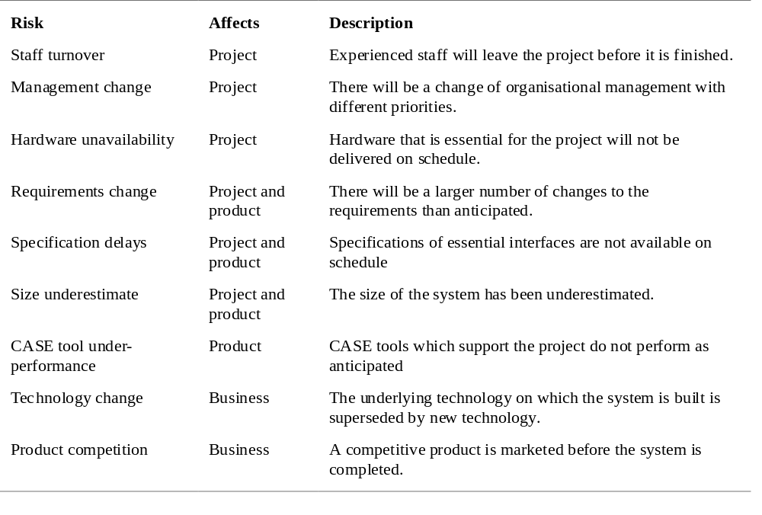
Software risks

Slide 20
The risk management process
Risk identification
  Identify project, product and business risks;
Risk analysis
  Assess the likelihood and consequences of these risks;
Risk planning
  Draw up plans to avoid or minimise the effects of the risk;
Risk monitoring
  Monitor the risks throughout the project;
  Discuss the risk management process

Slide 21
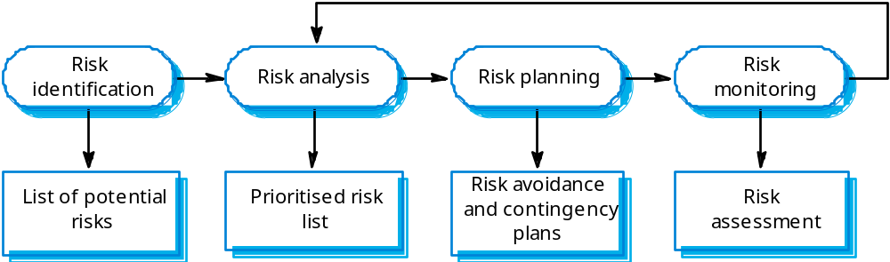
The risk management process

Slide 22
Risk identification
Technology risks.
People risks.
Organisational risks.
Requirements risks.
Estimation risks.

Slide 23
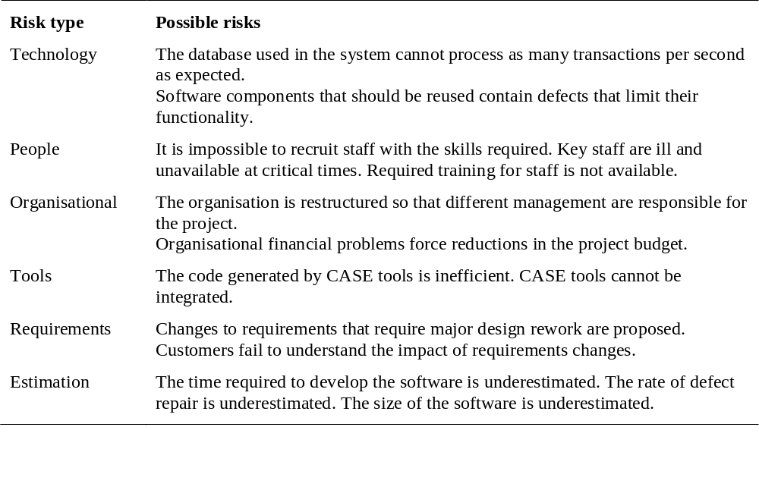
Risks and risk types

Slide 24
Risk analysis
Assess probability and seriousness of each risk.
Probability may be very low, low, moderate, high or very high.
Risk effects might be catastrophic, serious, tolerable or insignificant.

Slide 25
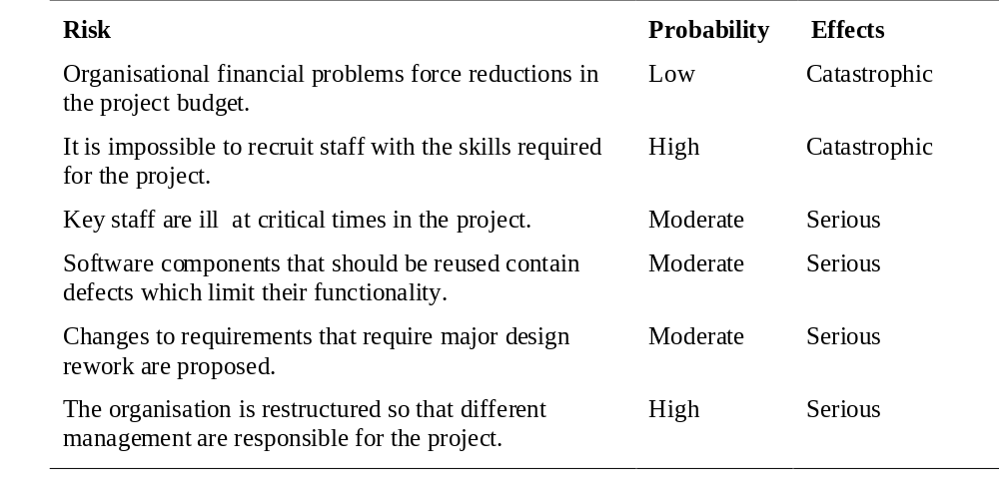
Risk analysis (1)

Slide 26
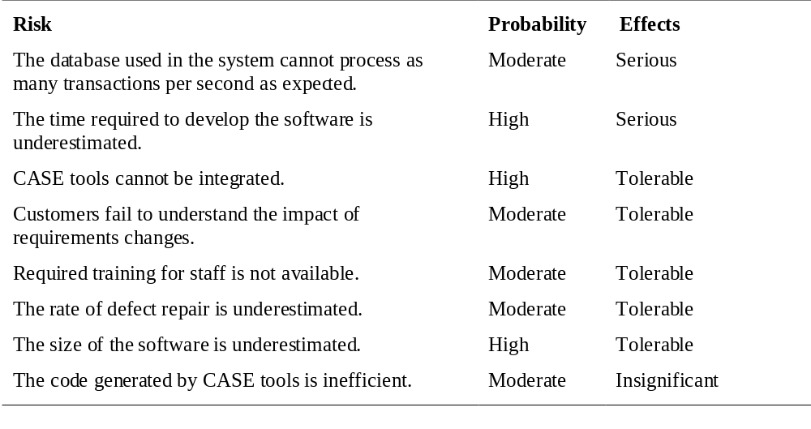
Risk analysis (2)

Slide 27
Risk planning
Consider each risk and develop a strategy to manage that risk.
Avoidance strategies
  The probability that the risk will arise is reduced;
Minimisation strategies
  The impact of the risk on the project or product will be reduced;
Contingency plans
  If the risk arises, contingency plans are plans to deal with that risk;

Slide 28
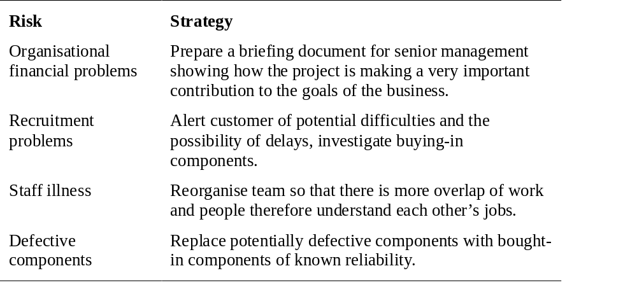
Risk management strategies (1)

Slide 29
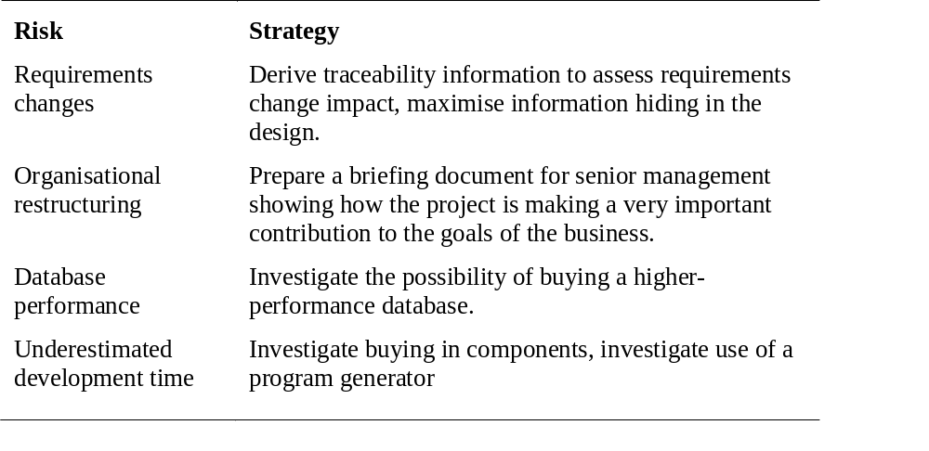
Risk management strategies (2)

Slide 30
Risk monitoring
Assess each identified risks regularly to decide whether or not it is becoming less or more probable.
Also assess whether the effects of the risk have changed.
Each key risk should be discussed at management progress meetings.

Slide 31
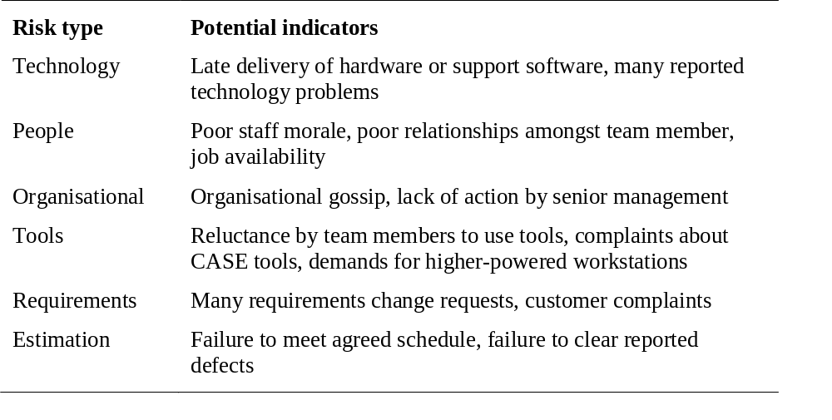
Risk indicators

Slide 32
Reference
CT-03 (Next Monday: March 10, 2014)
  Process and Project Metrics
  Project Management
Chapter 5
Book : Sommerville (7th Edition)
Chapter 4 (Only PERT chart)
  Book: Whitten

Slide 33
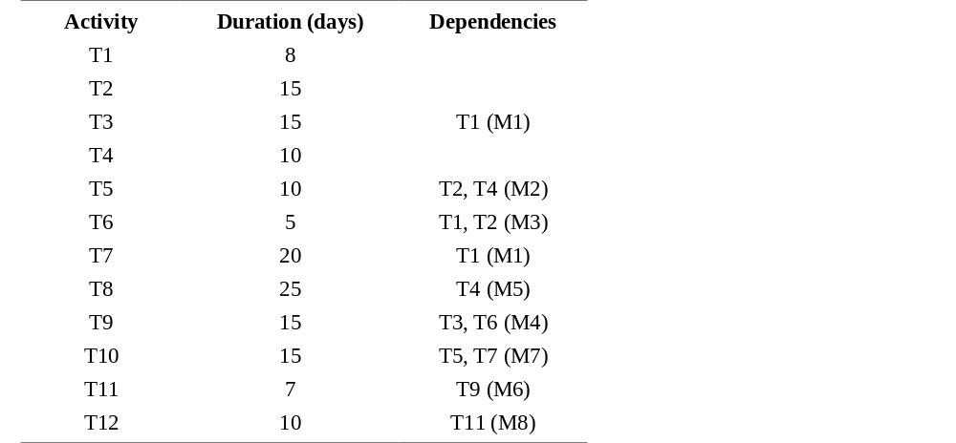
Task durations and dependencies

Slide 34
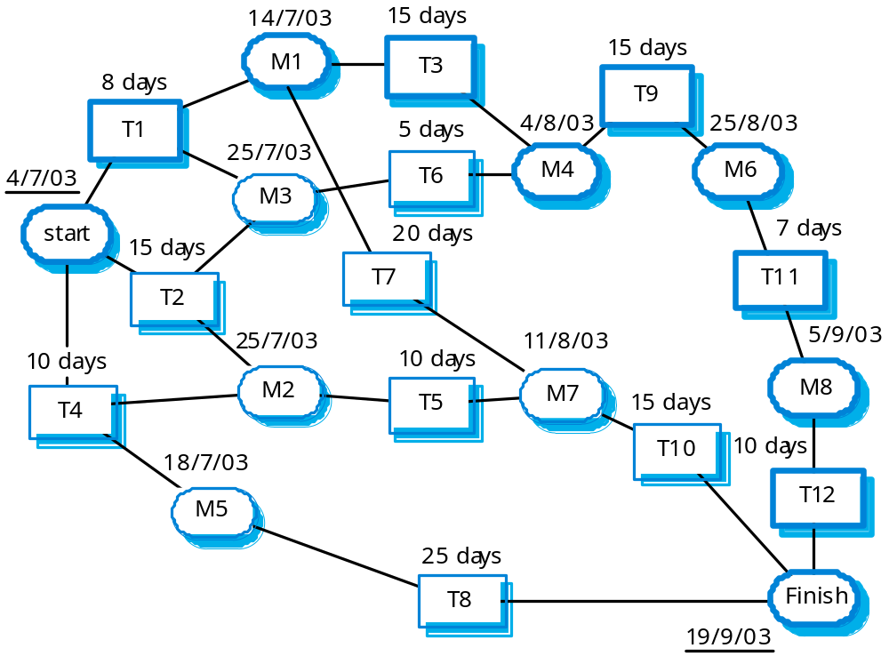
Activity network

Slide 35
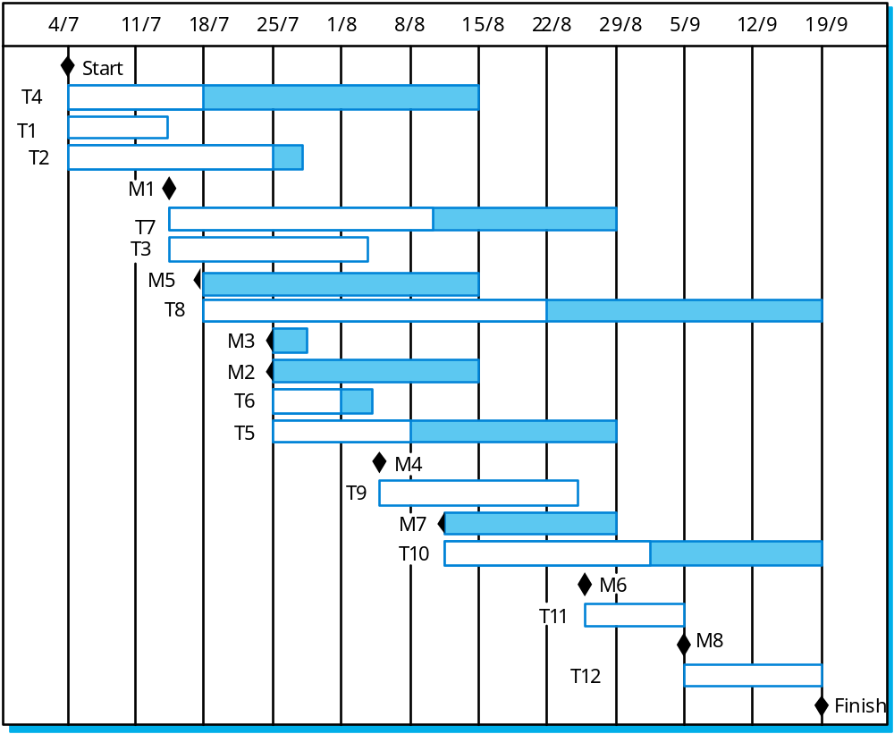
Activity timeline

Slide 36
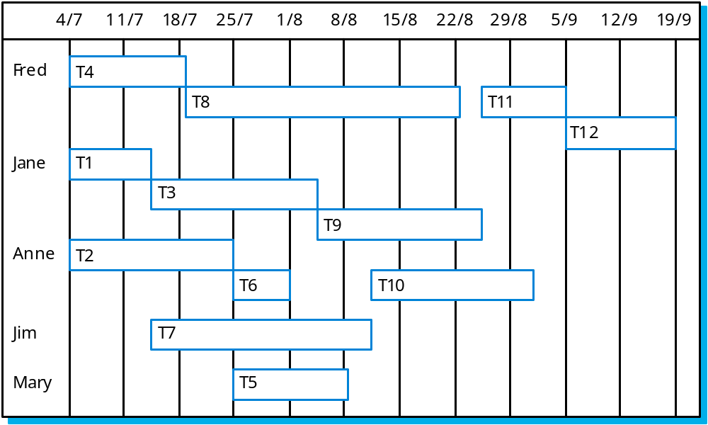
Staff allocation

Slide 37
PERT CHART
A | 1
1 | 1
B | 3
3 | 4
Task | Pred | Dur
A | - | 1
B | - | 3
C | A | 3
D | B,C | 5
E | C | 1
F | D | 4
G | E,F | 3
H | G | 2
I | G | 2
J | H,I | 5
K | J | 6
C | 3
4 | 4
D | 5
9 | 9
E | 1
5 | 13
F | 4
13 | 13
G | 3
16 | 16
H | 2
18 | 18
I | 2
18 | 18
J | 5
23 | 23
K | 6
29 | 29

